Slide 1


SQL Server 2022
Intelligent Query Processing (IQP)

Slide 2
What is it?
First introduced in SQL 2017, IQP is a family of features designed to improve the performance of existing workloads in SQL Server with zero to minimal implementation effort to adopt.

Slide 3

What’s new in SQL 2022?
Cardinality Estimation (CE) Feedback
Degree of Parallelism (DOP) Feedback
Memory Grant Feedback Enhancements
Parameter Sensitive Plan Optimization

Slide 4

Cardinality Estimation (CE) Feedback

Slide 5
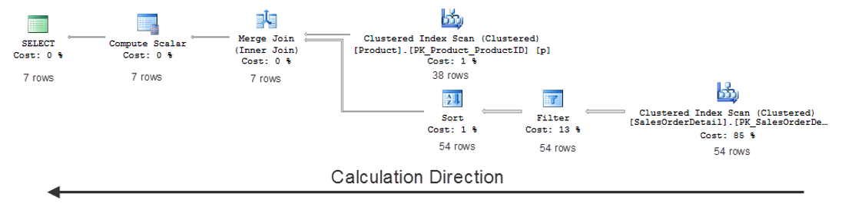
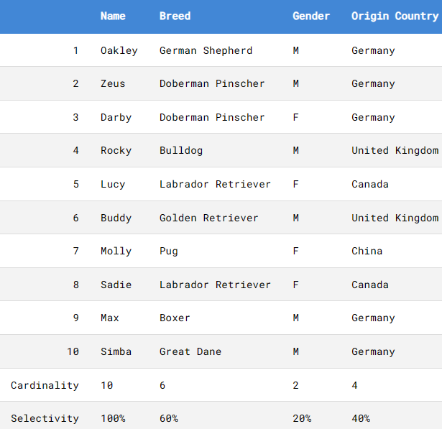
What is Cardinality Estimation (CE)?
The SQL Optimizer’s estimate of the number of rows that will be processed for each operator in the query plan.
This estimate is based on the cardinality of the table or tables in your query, as well as the cardinality from predicate expressions (WHERE and JOIN filters).
CE influences memory grant, types of join operations used, access methods, etc. In other words, it determines the query plan shape.
CE
CE
cardinality
Refers to the individual uniqueness of values in a specific column or index.

Slide 6
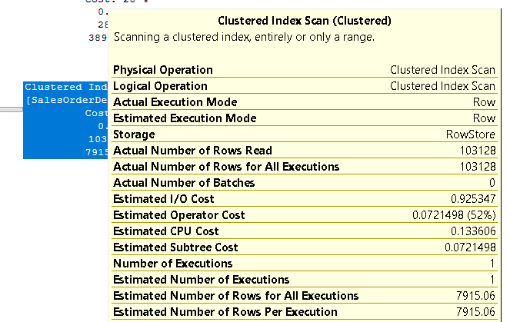
What if the estimate is wrong?
Serial plan is selected when parallel is more optimal (underestimation)
Parallel plan is selected when serial is more optimal (overestimation)
Inappropriate join strategy, e.g., Nested Loop instead of Hash Join (underestimation)
Inefficient navigation strategy (i.e., seek vs scan)
Inflated memory grant
Tempdb spill
Actual
Estimate
Poor CE = Poor performance

Slide 7
How does CE work?
CE Model Core Assumptions
It is performed by the Cardinality Estimator – a component within the SQL Optimizer that predicts how many rows will be returned from each step of the query plan.
Cardinality Estimator uses a model that is composed of a set of assumptions about the distribution of data to answer questions such as:
How many distinct values do we expect from a specific column. How about a set of columns?
How many rows will satisfy a single predicate (or multiple predicates)?
How many rows will satisfy a join predicate between two tables?
The assumptions used become the basis of choosing the mathematical algorithm to calculate the cardinality.
SQL Server 7.0 – 2012 (CE 70)
Uniformity: Assumes uniform data distribution (i.e., unique values are evenly distributed and have the same frequency within each step in the histogram)
SQL Server 2014 (CE 120)
Independence becomes Correlation: Multiple column values in a predicate may actually be dependent on each other, which is more representative of real-life data.
Independence: The distribution of data in different columns is independent of other columns.
Simple Containment: Users will always query for data that exists. If you are joining two tables using “ProductID”, consider the selectivity of ProductID in each table.
Inclusion: For a WHERE clause like NAME = “John”, the value “John” is assumed to exist in the NAME column.
Simple Containment becomes Base Containment: Users may query for data that doesn’t exist.

Slide 8


Problem with Cardinality Estimation
CE 120
CE 120
Legacy CE
Workload - A
Workload - B
Workload - B
There is no one-size-fits-all CE!

Slide 9

Introducing: CE Feedback (DB 160)
A feature that learns over time, which CE model assumptions are optimal and applies it to repeating queries.
Reduces regression risks related to CE when upgrading SQL Server.
How does it work?
STEP 1: Analyze and identify model related assumptions for repeating queries.
STEP 2: Provide feedback (i.e., modifies assumption) using query hints on subsequent execution and validate outcome.
STEP 3: If adjustment improves performance, feedback is persisted in Query Store. Otherwise, feedback is not persisted, and CE reverts to original assumption used (Do-no-harm policy).
CE Feedback
CE 70 Assumptions
Workload - A
Workload - B
CE 120 Assumptions
CE Feedback can adjust the CE during optimization, using different model assumptions, from the legacy to the latest CE model in order arrive at the most optimal cardinality estimation.

Slide 10
Considerations for CE Feedback
To enable, set DB Compat to 160
Query Store must be enabled and set to R/W
Can be monitored via XEvents (query_feedback_analysis, query_feedback_validation)
Hints set by CE Feedback can be tracked using sys.query_store_query_hints
Feedback information can be tracked using sys.query_store_plan_feedback.
To disable, use ALTER DATABASE SCOPED CONFIGURATION SET CE_FEEDBACK = OFF
To disable at the query level, use DISABLE_CE_FEEDBACK query hint
If there is an existing query plan forced through Query Store, CE Feedback will not be used for that query.
Hard-coded query hints or using Query Store hints set by the user will effectively disable CE Feedback for that query

Slide 11

Demo (CE Feedback)

Slide 12

Degree Of Parallelism (DOP) Feedback

Slide 13
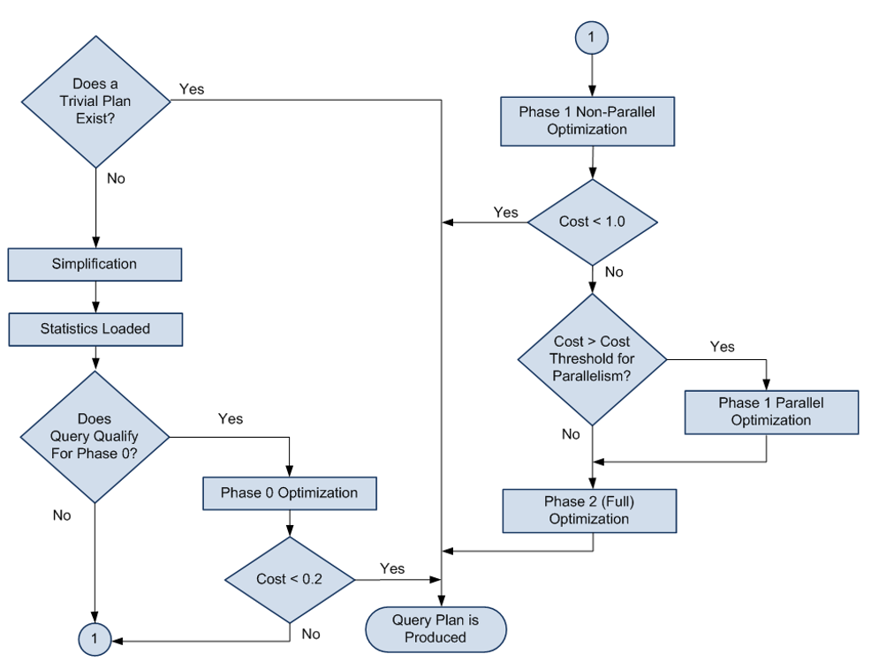
SQL Server Optimization Process
During Phase 1 of the query optimization process, the SQL Optimizer decides whether to use a serial or parallel plan.
If the SQL Optimizer opts for a parallel plan, multiple CPUs will be used to run the query.
The number of CPUs a parallel plan can use is determined by many factors including an Instance-level setting called Maximum Degree of Parallelism (MAXDOP, for short).
What is MAXDOP?
A server configuration to limit the maximum number of processors SQL can use for executing a query.
See: Configure the max degree of parallelism (MAXDOP) - Azure SQL Database | Microsoft Learn
How many CPUs = MAXDOP

Slide 14
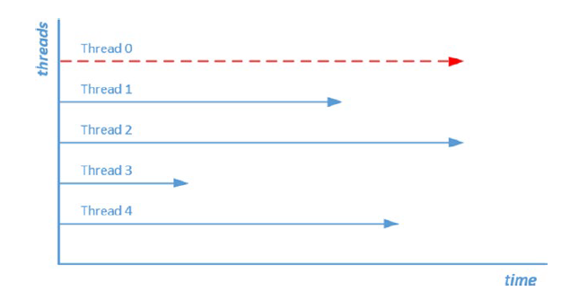
When Parallelism goes bad
Parent/Coordinating thread
Parallelism is meant to improve the performance of a query by dividing the workload across multiple CPUs.
However, there are times when parallelism can cause performance issues, such as when the distribution of workload across the CPUs is uneven.
As a result, worker threads may be waiting on each other to complete. The overhead of coordinating the parallel operation now becomes an problem in itself.
In these cases, limiting the MAXDOP can help mitigate the performance impact of over-parallelism.
High CXPACKET wait time
High CXPACKET wait time

Slide 15
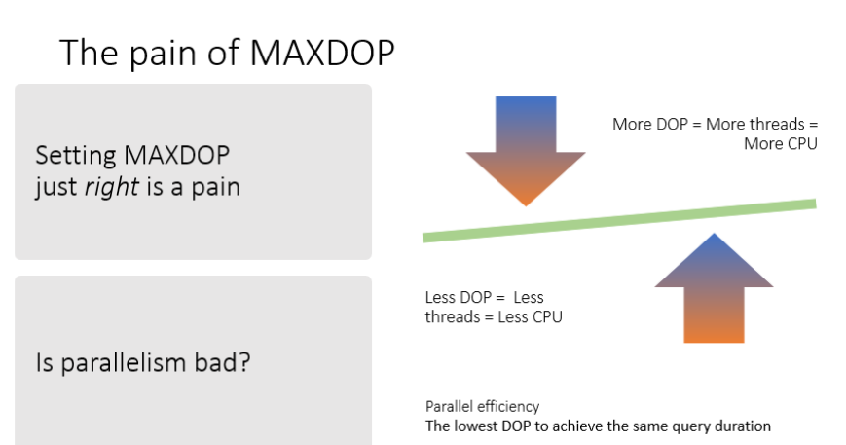
What’s the right MAXDOP setting?
Caveats of manually setting MAXDOP
Set it too high, you can run into CPU issues (e.g., Thread starvation)
Set it too low, you can miss out on performance benefits of parallelism
Reactive – would only be changed when there is a problem
Determining optimal DOP for each query in the workload can be time-consuming and arduous; requires code-change

Slide 16

Introducing DOP Feedback
A feature that analyzes any parallel query and determines if it might perform better with a lower degree of parallelism than what is currently being used.
NOTE: DOP Feddback does not change the plan, only the DOP value
Sits between RG and Thread Availability
It works at the Plan-level
Iterative and Incremental
Uses a pre-defined DOP array of values
No. of Threads Available
Query 1
Validate
Analyze
{
128,
104
80,
64,
48,
32,
20,
16,
12,
8,
6,
4,
2
}
DOP Feedback
Resource Governor
Plan 1
Plan 2
Query hint
Provide Feedback
Database-level
Feedback 1
Feedback 2
Instance-level

Slide 17
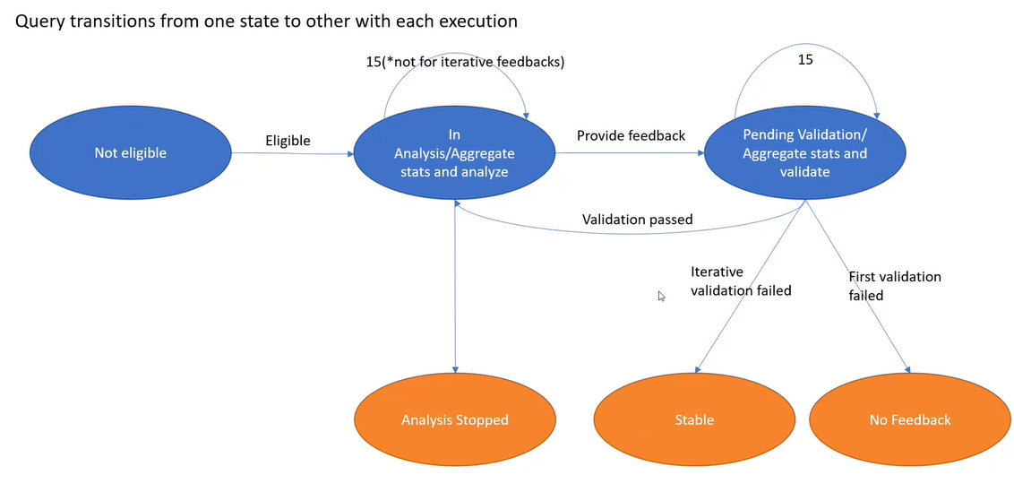
DOP Feedback Workflow

Slide 18
Eligibility Criteria
Query has been captured by QDS
Must be a successful execution
Not a system query
Only SELECT statements
Doesn’t have a recompile or disable_dop_feedback hint
Query DOP > 2 and <= 128
“Adjusted” elapsed time >= 10 secs.
Only “fresh” queries (i.e., compiled or recompiled)

Slide 19
Supportability
XEvents: 7 new events
dop_feedback__eligible_query
dop_feedback__analysis_stopped
dop_feedback__provided
dop_feedback__validation
dop_feedback__stabilized
dop_feedback__reverted
dop_feedback__reassessment_failed
Helps in understanding which state the query currently is within the DOP Feedback workflow
DMVs: sys.query_store_plan_feedback
Where feedback is persisted.
Query Hint:
Option(USE HINT(‘DISABLE_DOP_FEEDBAK’))
DB Scoped Config:
ALTER DATABASE SCOPED CONFIGURATION SET DOP_FEEDBACK = OFF
Server Level Feature Switch:
Default state = ON
dbcc traceon(12061, -1)
SHOWPLAN XML:
New attributed: “IsDOPFeedbackAdjusted” Reflects whether or not the feedback has been applied for the current execution.
Valid Values:
“Yes: Adjusting”
“Yes: Stable”
“No Feedback”

Slide 20
Demo (DOP Feedback)

Slide 21

Memory Grant
Feedback (enhancements)

Slide 22
What is a Memory Grant?
Goes by many names: Workspace Memory, Query Execution (QE) Memory, QE Reservation, Memory Reservation
Mainly used for sort and hashing operations within a query plan
Lifetime of Memory Grant is the same as the lifetime of query
Query Optimizer can only estimate how much memory is required to execute a query.
Overestimation = Bad
Underestimation = Worst

Slide 23
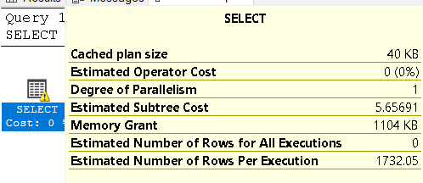
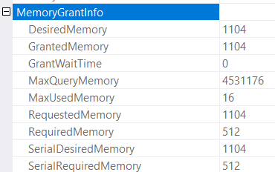
Looking at Memory Grant
SerialRequiredMemory / Required Memory
Minimum amount of memory for the query to start execution.
Needed to create internal data structures for memory consuming operators.
Calculated at compile time.
Serial Desired Memory / Desired Memory
Required memory + ideal memory for all data to be processed in memory
Depends on cardinality and size estimates.
Calculated at compile time.
Requested Memory
Amount of memory actually requested for the query.
Can be less than DesiredMemory (or even RequiredMemory) if for example there is system memory shortfall
GrantedMemory
Amount of memory actually granted to the query.
MaxUsedMemory
Amount of memory actually used by the query during execution time.
GrantWaitTime
Amount (in milliseconds) that query had to wait before memory is granted.
Think, RESOURCE SEMAPHORE waits.
Notes:
Best place to look at memory grant is in the Actual Execution Plan. This is, after all, where memory grant is calculated, granted, and used.

Slide 24
Problems with Memory Grant
Overestimation
Wasted memory
Underestimation
Tempdb spill
Typical Causes
Poor cardinality estimates
Impact the performance of other queries
Inhibit parallelism
May cause concurrency issues
Slow query
Tempdb pressure
Stale statistics
Badly defined data types
Not eliminating rows early in the query
Selecting more columns than you need
Selecting all your columns at once

Slide 25
Quick Demo (of the problem)

Slide 26
What is Memory Grant Feedback?
Attempts to remember the memory needs of previous query executions to adjust memory grant accordingly
Initially only worked with Batch mode operators and Column Store indexes (SQL 2017 and DB COMPAT=140)
Now works with Row mode operators starting SQL 2019 (and DB COMPAT=150)
SQL 2022 improves feedback algorithm and makes feedback persistence possible (DB COMPAT >= 140)

Slide 27
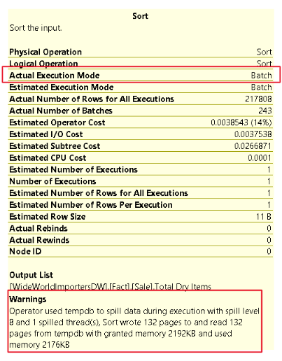
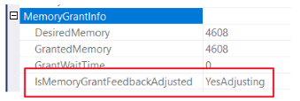
Batch Mode Memory Grant Feedback (2017)

Slide 28
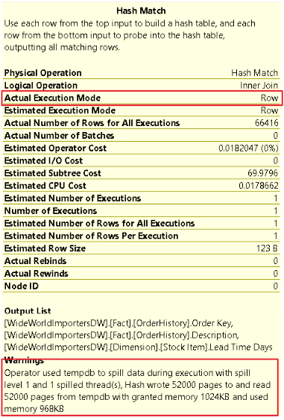
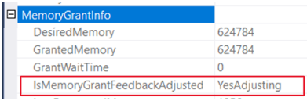
Row Mode Memory Grant Feedback (2019)

Slide 29
Percentile Feedback and Persistence (2022)
Problem: Cache Eviction
Feedback is not persisted if the plan is evicted from cache or failover
Solution: Persist the feedback
Persist the memory grant feedback in the Query Store
Record of how to adjust memory is lost and must re-learn
Problem: Oscillating Feedback
Memory grants adjusted based on last feedback
Parameter Sensitive Plans could cause MGF to consistently miss its mark
Solution: Percentile-based calculation
Using data from previous executions, a new percentile algorithm is applied to account for erratic patterns of memory grant requirement
ALTER DATABASE SCOPED CONFIGURATION SET MEMORY_GRANT_FEEDBACK_PERSISTENCE = [ON | OFF];
Enabled by default on SQL 2022 or DB COMPAT >= 140
Enabled by default on SQL 2022 or DB COMPAT >= 140
ALTER DATABASE SCOPED CONFIGURATION SET MEMORY_GRANT_FEEDBACK_PERCENTILE_GRANT = [ON | OFF];

Slide 30
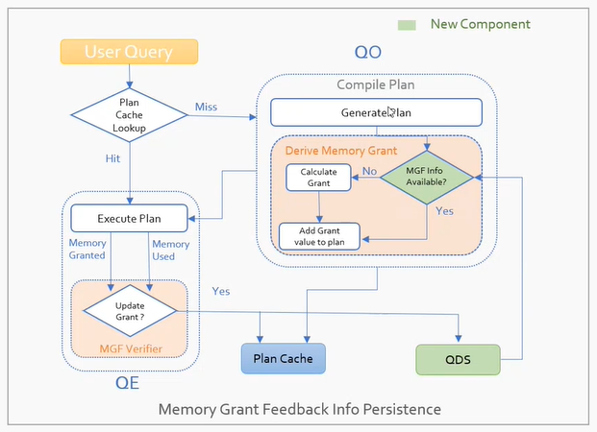
Feedback Persistence
Persisted Feedback
MGF is now persisted in Query Store to address the issue of losing MGF data from the plan cache due to recompilations, restarts, etc.
Minimize overhead
Intelligent policy controlling when to persist
Storing feedback in QDS is done asynchronously using a background thread

Slide 31
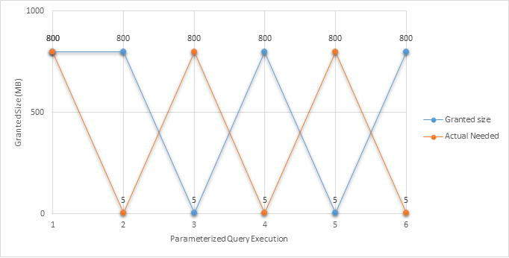
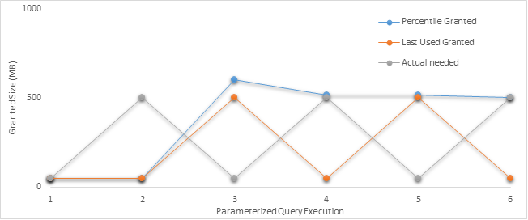
Oscillating Pattern Problem

Slide 32
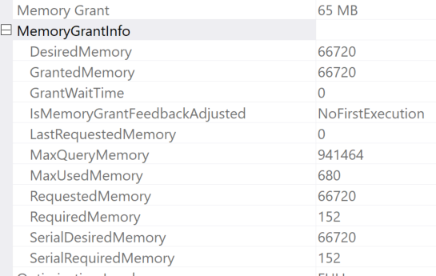
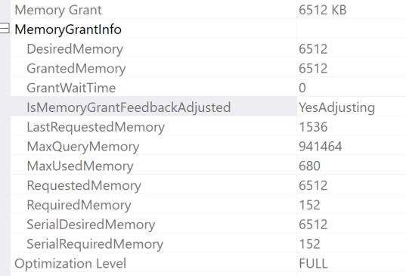
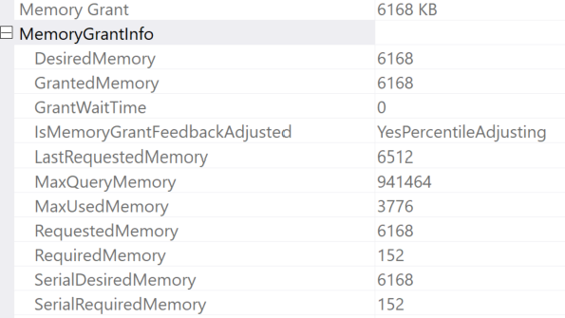
New Plan Attributes for MGF

Slide 33
Values of New MGF Plan Attributes
IsMemoryGrantFeedbackAdjusted | Description
No: First Execution | Memory grant feedback doesn't adjust memory for the first compile and associated execution.
No: Accurate Grant | If there's no spill to disk and the query uses at least 50% of the granted memory, then memory grant feedback isn't triggered.
No: Feedback disabled | If memory grant feedback is continually triggered and fluctuates between memory-increase and memory-decrease operations, the database engine will disable memory grant feedback for the statement.
Yes: Adjusting | Memory grant feedback has been applied and may be further adjusted for the next execution.
Yes: Percentile Adjusting | Memory grant feedback is being applied using the percentile grant algorithm, which looks at more history than only the most recent execution.
Yes: Stable | Memory grant feedback has been applied and granted memory is now stable, meaning that what was last granted for the previous execution is what was granted for the current execution.

Slide 34
MGF-related XEvents
XEvent | Description
memory_grant_updated_by_feedback | Memory grant feedback doesn't adjust memory for the first compile and associated execution.
memory_grant_feedback_percentile_grant | If there's no spill to disk and the statement uses at least 50% of the granted memory, then memory grant feedback isn't triggered.
memory_grant_feedback_loop_disabled | If memory grant feedback is continually triggered and fluctuates between memory-increase and memory-decrease operations, the database engine will disable memory grant feedback for the statement.
memory_grant_feedback_persistence_invalid | Memory grant feedback has been applied and may be further adjusted for the next execution.
memory_grant_feedback_persistence_update | Memory grant feedback is being applied using the percentile grant algorithm, which looks at more history than only the most recent execution.

Slide 35
Demo (MGF Feedback)

Slide 36

Parameter Sensitive Plan Optimization (PSPO)

Slide 37

Is Parameter Sniffing bad?
Parameter Sniffing
Plan Caching
Good Parameter Sniffing
Good Parameter Sniffing
The SQL Optimizer’s way of evaluating parameter values of queries and storing them with the execution plan in the Plan Cache. This is an optimization feature designed to create query plans that are optimal for the same values and can be reused on subsequent executions. After all, compiling queries is expensive.
Notes:
Parameter Sniffing is an optimization feature of the SQL Optimizer.
Meaning, it’s meant to optimize the performance of your query.
This is when the SQL Optimizer looks or “sniffs” the parameter values of a stored procedure to compile an execution plan based on these values.

Slide 38
When is Parameter Sniffing a Problem?
Parameter Sniffing
Plan Caching
Skewed Data Distribution
Bad Parameter Sniffing
Bad Parameter Sniffing
Refers to a scenario where a single cached plan for a parameterized query is not optimal for all possible incoming parameter values.

Slide 39
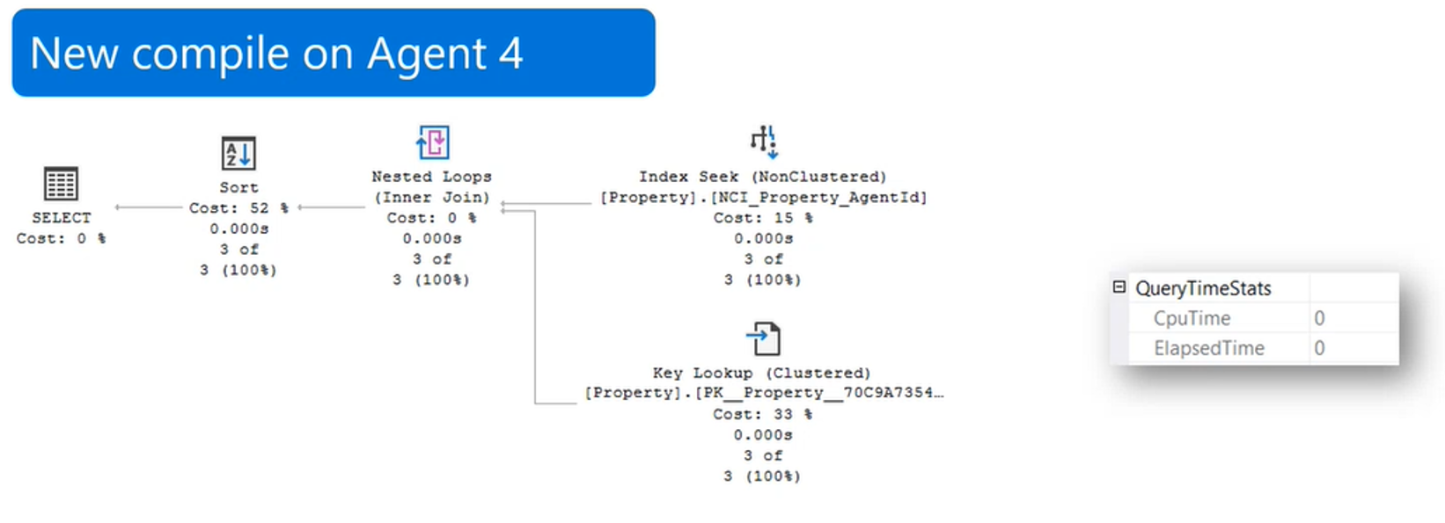
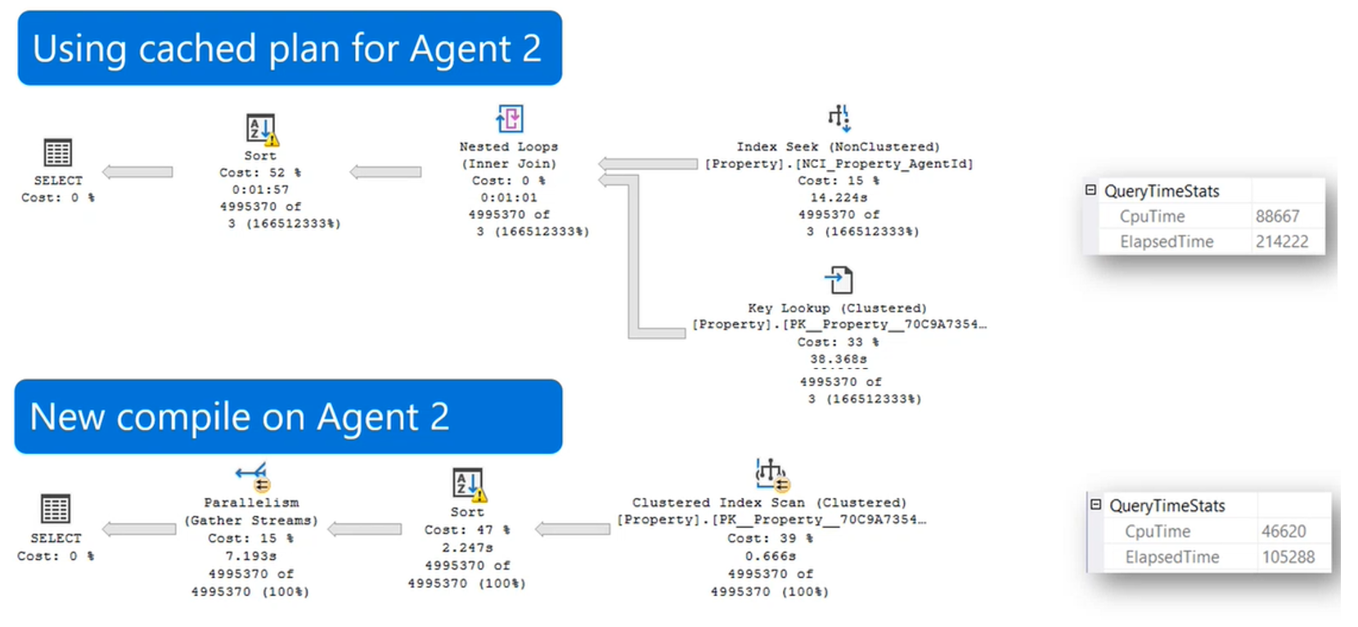
Example Scenario

Slide 40
Options (pre-SQL Server 2022)
With RECOMPILE (or OPTION(RECOMPILE))
Use local variables to disable parameter sniffing
Use of multiple stored procedures
OPTION(OPTIMIZE FOR [Unknown | Value])
Use Trace Flag 4136 to disable parameter sniffing
ALTER DATABASE SCOPED CONFIGURATION SET PARAMETER_SNIFFING = OFF;

Slide 41
Introducing: Parameter Sensitive Plan Optimization (PSPO)
Enabled using DB Compat 160
The feature uses multiple, active cached plans for a single parameterized statement
Cached execution plans are designed to accommodate different data sizes
Built-in limit on the number of plans generated and cached to prevent cache bloat
These plans account for up to 3 predicate ranges – small, medium, and large

Slide 42
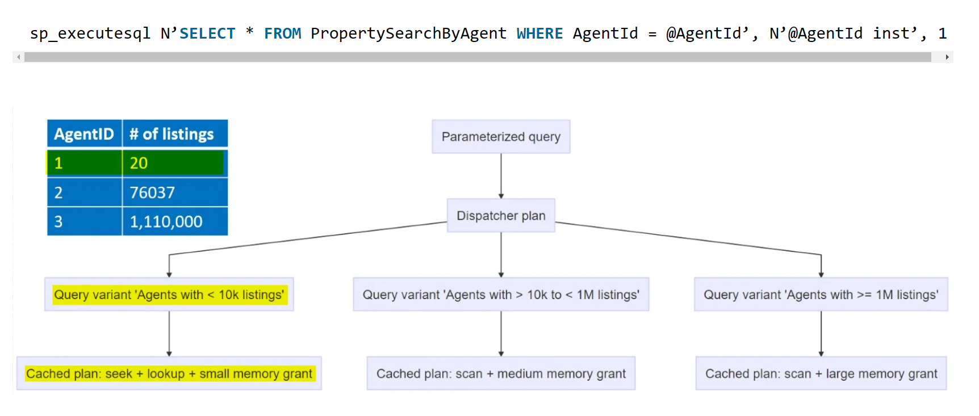
How it works
Dispatcher Plan
“Shell” plan created in XML after a parameterized query is initially compiled
Stored in the plan cache and Query Store
Uses Dispatcher Expression (i.e., PSPO logic) to generate Query Variants
Query Variants
Up to three for each Dispatcher Plan
Stored in the plan cache and Query Store

Slide 43
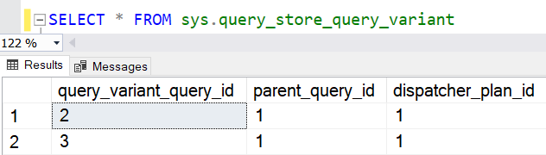
Telemetry (DMVs)
sys.query_store_query_variant
Shows query IDs of all query variants created by PSPO and the query ID of the Dispatcher plan that generated them.
Intended to be used in conjunction with Query Store DMVs
Below query exposes more details about Dispatcher Plans created by PSPO
SELECT qt.query_sql_text, qt.query_text_id, q.query_id, q.object_id, OBJECT_NAME(q.object_id), q.query_hash, qv.query_variant_query_id, qv.parent_query_id, qv.dispatcher_plan_id, p.plan_type, p.plan_type_desc, TRY_CAST(p.query_plan AS XML) AS xml_plan
FROM sys.query_store_query_text qt
JOIN sys.query_store_query q ON qt.query_text_id = q.query_text_id
JOIN sys.query_store_query_variant qv ON q.query_id = qv.parent_query_id
JOIN sys.query_store_plan p ON qv.dispatcher_plan_id = p.plan_id;
GO
Below query exposes more details about Query Variants
SELECT qt.query_sql_text, q.query_id, q.object_id, qv.query_variant_query_id, qv.parent_query_id, q.query_hash,
rs.count_executions, qsp.plan_id, qv.dispatcher_plan_id, qsp.query_plan_hash, TRY_CAST(qsp.query_plan as XML) AS xml_plan
FROM sys.query_store_query_text qt
JOIN sys.query_store_query q ON qt.query_text_id = q.query_text_id
JOIN sys.query_store_plan qsp ON q.query_id = qsp.query_id
JOIN sys.query_store_query_variant qv ON q.query_id = qv.query_variant_query_id
JOIN sys.query_store_runtime_stats rs ON qsp.plan_id = rs.plan_id
ORDER BY qv.parent_query_id;
GO

Slide 44
Telemetry (XEvents)
CREATE EVENT SESSION [PSPO] ON SERVER
ADD EVENT sqlserver.parameter_sensitive_plan_optimization,
ADD EVENT sqlserver.parameter_sensitive_plan_optimization_skipped_reason,
ADD EVENT sqlserver.parameter_sensitive_plan_testing,
ADD EVENT sqlserver.query_parameterization_data,
ADD EVENT sqlserver.query_with_parameter_sensitivity
WITH (MAX_MEMORY=4096 KB,EVENT_RETENTION_MODE=ALLOW_SINGLE_EVENT_LOSS,MAX_DISPATCH_LATENCY=30 SECONDS,MAX_EVENT_SIZE=0 KB,MEMORY_PARTITION_MODE=NONE,TRACK_CAUSALITY=OFF,STARTUP_STATE=ON)
GO
parameter_sensitive_plan_optimization
This event is fired when a query uses Parameter Sensitive Plan (PSP) Optimization feature.
parameter_sensitive_plan_optimization_skipped_reason
Occurs when the parameter sensitive plan feature is skipped. Use this event to monitor the reason why parameter sensitive plan optimization is skipped
parameter_sensitive_plan_testing
Fired when parameter sensitive plan is tested.
query_with_parameter_sensitivity
This event is fired when a query is discovered to have parameter sensitivity. This telemetry will help us in identifying queries that are parameter sensitive and how skewed the columns involved in the query are.

Slide 45
Demo (PSPO)

Slide 46
Thank you!

